Slide 1
Üzemanyag cellák-tüzelőanyagcellák

Slide 2
About Fuel Cells
A FUEL CELL is an electrochemical device that uses hydrogen and oxygen from the air to produce electricity, with water and heat as its by-products.
HYDROGEN can be sourced from fossil fuels, such as natural gas or propane, or renewable fuels including anaerobic digester gas and landfill gas. Hydrogen can also be produced by water electrolysis, which can be powered by electricity from renewables such as solar or wind power or from nuclear energy and the grid.
FUEL CELL BENEFITS
Exceptionally low/zero emissions
High quality, reliable power
Durable and rugged
Efficient – 50%+ electric efficiency, 90%+ electric and thermal efficiency (combined heat and power)
Quiet
Fuel flexible – can use conventional or renewable fuels
FUEL CELL CAPABILITIES
Motive
Fuel Cell Vehicles (FCVs) – replicates today’s driving experience: range of ~300 miles per hydrogen fueling, refuel at a pump in 3-5 minutes
Material Handling Equipment (MHE) – fuel cell provides constant power, without lag, over an entire shift, reliable operation in refrigerated environments, can refuel in minutes

Slide 3
Stationary
Flexible siting – indoors or outdoors
Lightweight – enables rooftop siting
Modular/scalable to meet any need, ranging from a few watts to multi-megawatt systems
Able to provide primary, supplemental, or backup power
Can be grid-tied, or can operate independently from the grid
Compatible with solar, wind, batteries and other renewable/conventional technologies
Can be used with, or instead of, fossil fuel generators
Requires less space than solar photovoltaics
Operates in water balance/uses very little water in operation
Portable
Refuel on the go by swapping a cartridge
Provides longer run times
Low-thermal, low-sound profile

Slide 4
EXAMPLES OF FUEL CELL APPLICATIONS
At the state and local level, fuel cells are helping meet environmental goals, boosting reliability and resiliency to ensure constant power, and saving taxpayer dollars and industry investment.
This includes primary and backup power to:
Government offices, jails, fire and police stations
Wastewater treatment plants
Communications and emergency networks
Schools and hospitals
Zoos, parks and gardens
Motive power for:
Airports (baggage tow tractors, nose wheels)
Ports (MHE)
Fleet vehicles
In the private sector, applications include some of the above as well as:
Facilities, such as retail stores, corporate headquarters, data centers, hotels, apartment buildings
Cell phone towers
Railroad signals
Electric grid substations, providing multi-megawatts of power to local users
Off-grid equipment for security, energy exploration, recreation
MHE
Buses operating on public routes
Automobiles

Slide 5
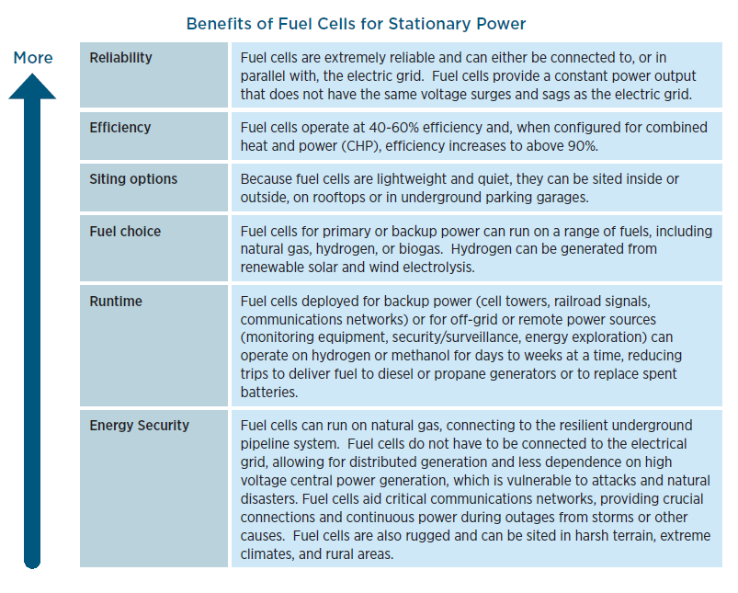

Slide 6
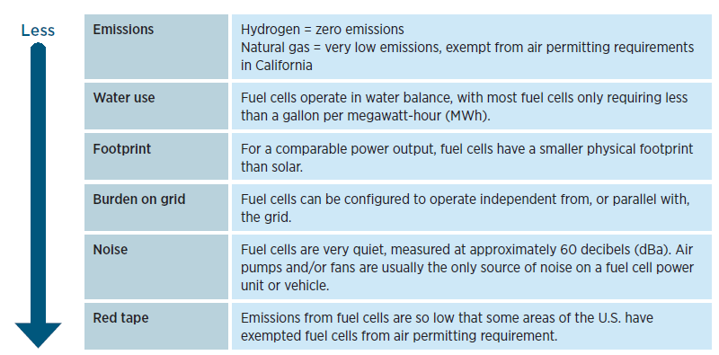

Slide 7
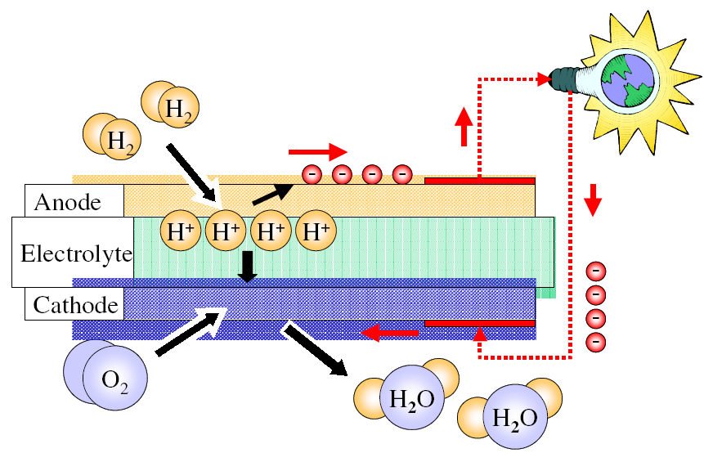
ÜZEMANYAGCELLÁK

Slide 8
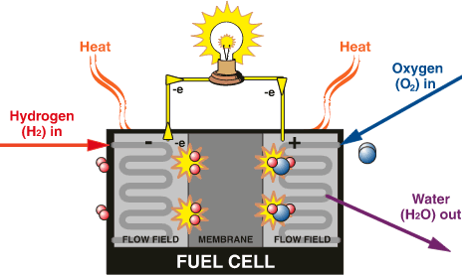

Slide 9
Az üzemanyagcellák az elemekhez hasonlóan vegyi reakciókkal közvetlenül elektromosságot állítanak elő, a különbség az, hogy míg az elemeket kifogytuk után el kell dobni, az üzemanyagcella mindaddig üzemel, amíg üzemanyagot töltünk bele. A szerkezet alapegysége két elektródából áll, egy elektrolit köré szendvicsszerűen préselve.
Az anódon hidrogén, míg a katódon oxigén halad át.
Katalizátor segítségével a hidrogénmolekulák protonokra és elektronokra bomlanak.
A protonok keresztüláramlanak az elektroliton.
Az elektronok áramlása mielőtt elérné a katódot, felhasználható elektromos fogyasztók által.
A katódra érkező elektronok a katalizátor segítségével egyesülnek a protonokkal és az oxigénmolekulákkal, vizet hozva létre.
A folyamat során hő is termelődik.
Az üzemanyag-átalakítót (reformer) tartalmazó rendszerek képesek felhasználni bármely szénhidrogén tüzelőanyagot, a földgáztól kezdve a metanolon át a gázolajig.
Inverter közbeiktatásával váltóáramot is hozhatunk létre (lásd a fenti ábrát).
Mivel az üzemanyagcella nem égésen alapul, hanem elektrokémiai reakción, az emissziója mindig jóval kisebb lesz, mint a legtisztább égési folyamatoknak.

Slide 10
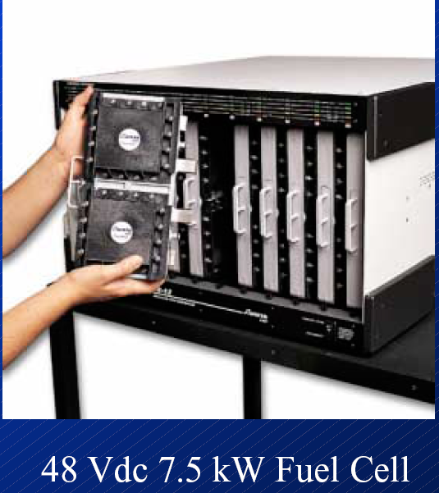
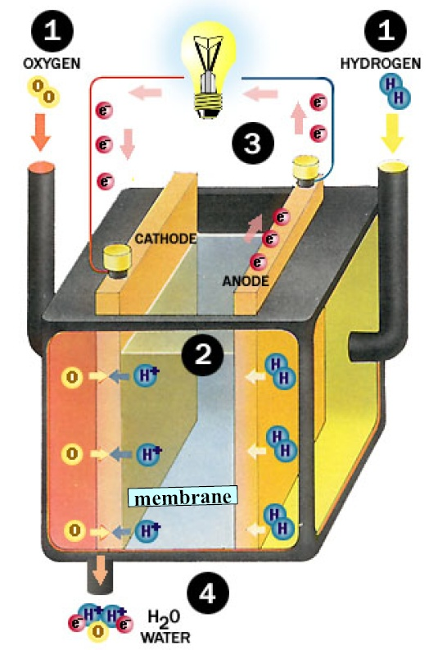
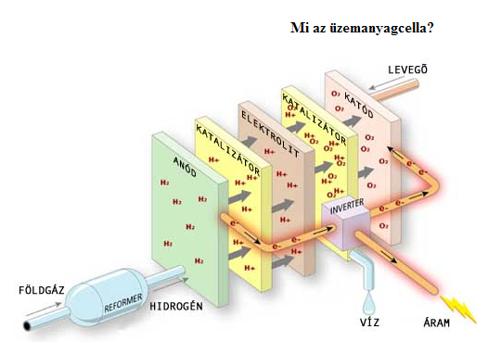
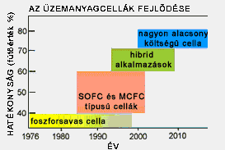

Slide 11
Az üzemanyagcelláknak számos fajtája van, melyeket a bennük használt elektrolit alapján csoportosítunk:
Üzemanyagcella típusa | Elektrolit | Működési hőmérséklet | Elektromos hatásfok | Üzemanyag | Felhasználási terület
AFC alkáli elektrolitos cella | 30% kálium-hidroxid oldat, gél | 80 ºC | elméleti: 70% gyakorlati: 62% | - tiszta H₂ - O₂ | - járműipar - hadiipar
PEMFC membránú cella | protonáteresztő membrán | 80 ºC | elméleti: 68% gyakorlati: 50% | - tiszta H₂ - O₂ - levegő | - blokkfűtő erőmű - járműipar - hadiipar
DMFC direkt metanol membrán | protonáteresztő membrán | 80 ºC-130 ºC | elméleti: 30% gyakorlati: 26% | - metanol, - O₂ - levegő | - mobiltelefon - laptop, stb. áramforrása
PAFC foszforsavas cella | tömény foszforsav | 200 ºC | elméleti: 65% gyakorlati: 60% | - tiszta H₂ - O₂ - levegő | - blokkfűtő erőmű - áramforrás
MCFC alkáli-karbonátsó cella | lítium-karbonát, kálium-karbonát | 650 ºC | elméleti: 65% gyakorlati: 62% | - H₂ - földgáz - széngáz - biogáz - levegő - O₂ | - gőzturbinás, kétlépcsős . blokkfűtő erőmű - áramforrás
SOFC oxidkerámia cella | yttrium-cirkon oxidkerámia | 800 ºC- 1000 ºC | elméleti: 65% gyakorlati: 62% | - H₂ - földgáz - széngáz - biogáz - levegő - O₂ | gőzturbinás, kétlépcsős . . blokkfűtő erőmű -áramforrás

Slide 12
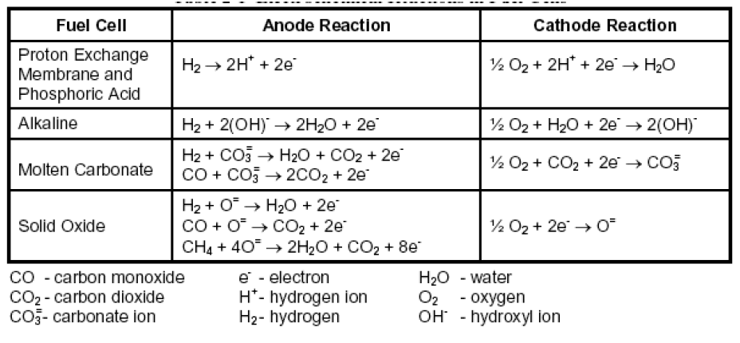

Slide 13
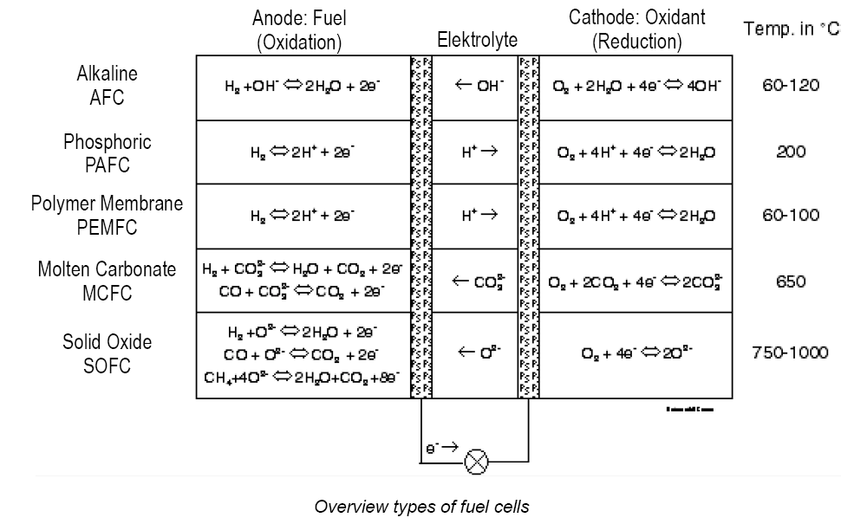

Slide 14
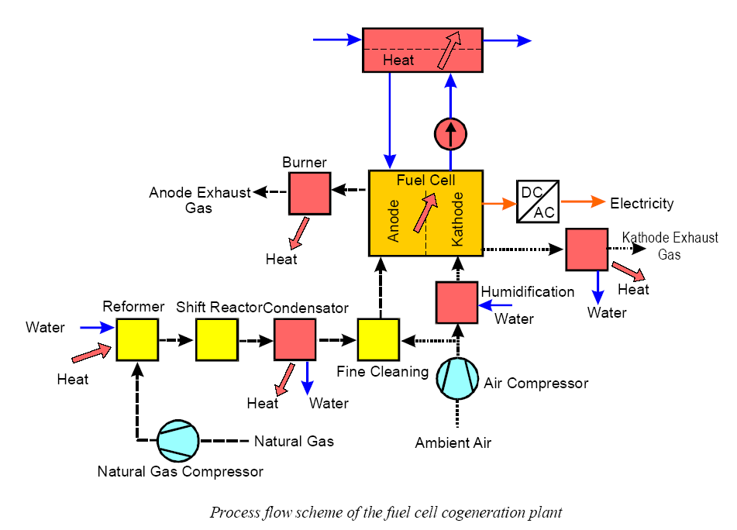
Dr. Pátzay György
14

Slide 15
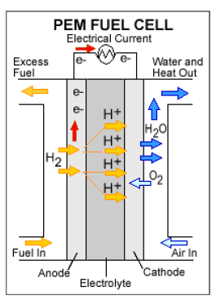
PEMFCs (Figure 3.4.1) are being considered for applications that require faster start-up times and frequent starts and stops, such as automotive applications, material handling equipment, and backup power. For PEMFCs, continuing advancements are needed to minimize or eliminate precious metal loading, improve component durability, and manage water transport within the cell. Additionally, membranes that are capable of operation at higher temperatures (up to 120°C for automotive applications and above 120°C for stationary applications) are needed for better thermal management. R&D is required to reduce cost and increase durability of the membrane electrode assembly (MEA) as well as optimize the integration of advanced cell components into the MEA. R&D is also required to reduce the cost and improve the durability of system BOP components, such as humidifiers and compressors.

Slide 16
Direct methanol fuel cells (DMFCs) are well suited for early market applications as sources of portable and backup power in consumer electronic devices and similar applications where the power requirements are low and the cost targets and infrastructure requirements are not as stringent as for transportation applications. A higher energy density alternative to existing technologies is required to fill the increasing gap between energy demand and energy storage capacity in these low power applications. Challenges for DMFCs include reducing Pt loading, reducing methanol crossover to increase efficiency, and simplifying the BOP to increase energy and power density, improve reliability, and reduce cost.

Slide 17
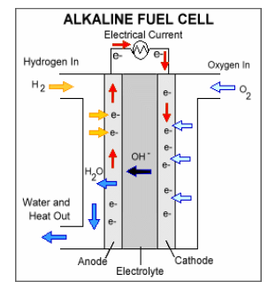
Alkaline fuel cells (AFCs) (Figure 3.4.2) were one of the first fuel cell technologies developed, and they were the first type widely used in the U.S. space program to produce electricity and water onboard spacecraft. One advantage of AFCs is that they can use a variety of nonprecious metal catalysts at the anode and cathode. The initial AFCs used aqueous potassium hydroxide (KOH) solutions as the electrolyte. To address some of the issues dealing with these liquid electrolytes, novel AFCs that use a polymer membrane as the electrolyte have been developed. These fuel cells are closely related to conventional PEMFCs except that they use an alkaline membrane instead of an acid membrane, and they are commonly referred to as AMFCs. Challenges for AMFCs include tolerance to carbon dioxide, membrane conductivity and durability, higher temperature operation, water management, power density, and anode electrocatalysis.

Slide 18
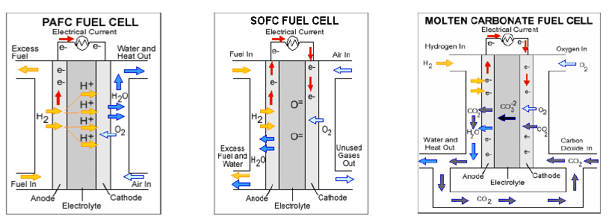
Medium-temperature (phosphoric acid) (Figure 3.4.3a) and high-temperature (solid oxide and molten carbonate) (Figure 3.4.3b and 3.4.3c, respectively) fuel cells are more applicable for systems that run for extended periods of time without frequent start and stop cycles. These systems also have benefits for CHP generation, and they offer simplified operation on fossil and renewable fuels. The high-temperature systems can also be utilized in tri-generation mode to produce electrical power, heat, and hydrogen. R&D needs for phosphoric acid-based fuel cells (PAFCs) include methods to decrease or eliminate anion adsorption on the cathode, lower cost materials for the cell stack and BOP components, and durable electrode catalyst and support materials. Polymer-phosphoric acid-based systems including polybenzimidazole-phosphoric acid type (PBI-type) have applications similar to PAFC. For high-temperature MCFCs, R&D is needed to limit electrolyte loss and prevent microstructural changes in the electrolyte support that lead to early stack failure. R&D is also needed to develop more robust cathode materials. For SOFCs, challenges include stack survivability during repeated thermal cycling, decreasing long start-up times, and potential mechanical and chemical compatibility/reactivity issues between the various stack and cell components due to high-temperature operation. For all of these systems, improved fuel processing and cleanup, especially for fuel-flexible operation and operation on biofuels, are needed to improve durability and reduce system costs. Table 3.4.1 describes the different fuel cell types discussed here.

Slide 19
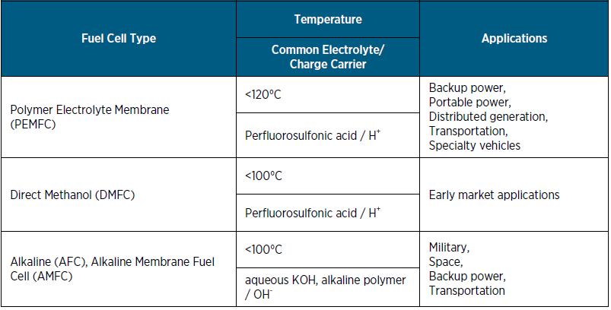
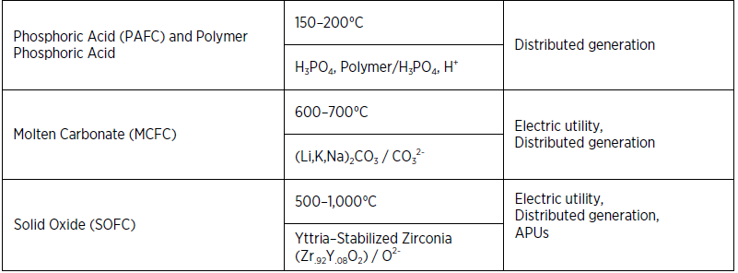

Slide 20
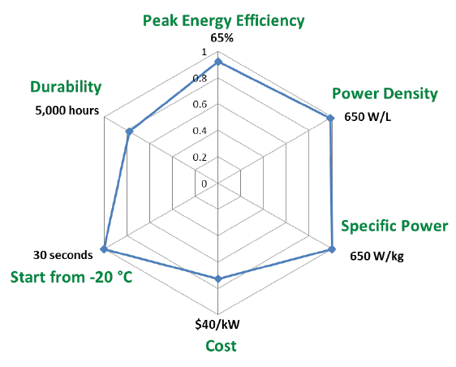
Transportation Systems
Light-Duty Vehicles
Fuel cell power system 2020 targets versus 2015 status (blue) for light-duty vehicle applications. (The status is indicated as a fraction of the targets.) Cost status is for a modeled system when manufactured at a volume of 500,000 units/year.

Slide 21
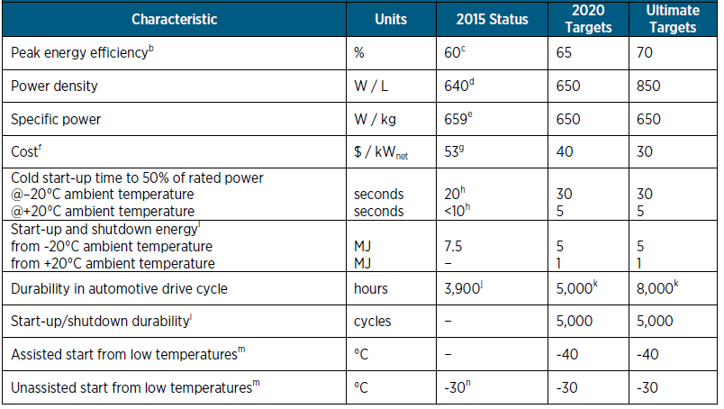
Technical Targets: 80-kWe (net) Integrated Transportation Fuel Cell Power Systems Operating on Direct Hydrogen a

Slide 22
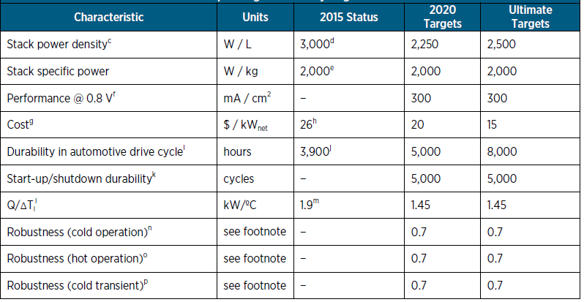

Slide 23
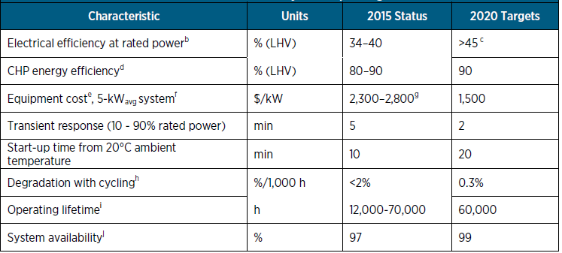
Technical Targets: 1–25kWe Residential and Light Commercial Combined Heat and Power and Distributed Generation Fuel Cell Systems Operating on Natural Gasa

Slide 24
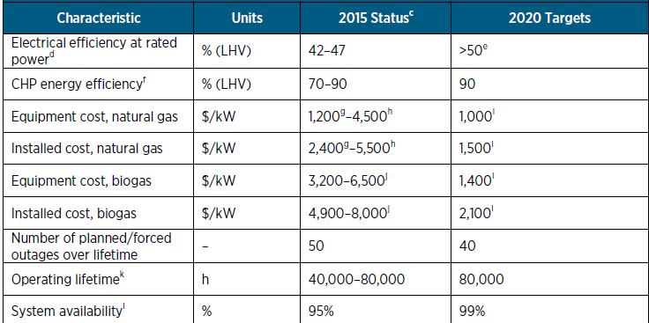
Technical Targetsa: 100 kW–3 MW Combined Heat and Power and Distributed Generation Fuel Cell Systems Operating on Natural Gasb

Slide 25
Hydrogen is an exceptionally energy-dense fuel by mass, higher than conventional fuels and substantially higher than batteries. However, volumetric energy densities are much lower so hydrogen in cars is compressed, either to 350 bar or more commonly to 700 bar.
Currently, more than 90% of road fuel is manufactured from crude oil globally. Hydrogen, by contrast, is manufactured from a wide variety of sources, presenting the opportunity for many countries to reduce their dependence on imported energy. There exists long industrial experience of manufacturing, storing, distributing and dispensing hydrogen: current world production would be sufficient to fuel 250 million fuel cell cars. Some hydrogen that is generated as a by-product in industrial processes is being used in FCEV.
One long-established production technology is the electrolysis of water: using electricity to split water into hydrogen and oxygen. This technique is particularly suitable for small-scale production, and many hydrogen refuelling stations make their own hydrogen on site by this method. If the electricity is provided from a renewable source, such as wind or solar power, then the production of the fuel emits no carbon. In this case, the hydrogen provides an additional benefit as a store of energy from renewable electricity.
The dominant industrial-scale production method at present is the steam reforming of methane, which can yield conversion efficiencies of up to 80%. This production method may be decarbonised in the future by the use of biogas as a feed, or by the capture and storage of the CO2 by-product. A further sustainable technology, which is starting to be applied at an industrial scale, is the gasification of biomass and waste.

Slide 27
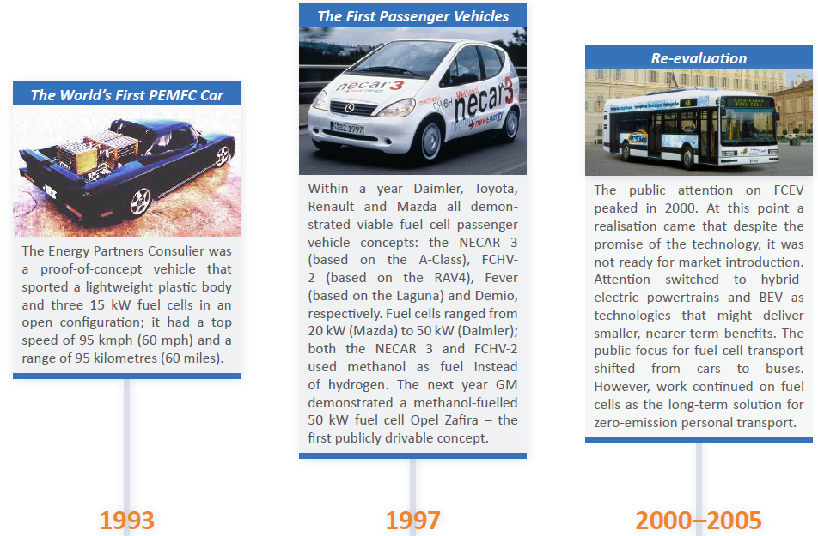

Slide 29
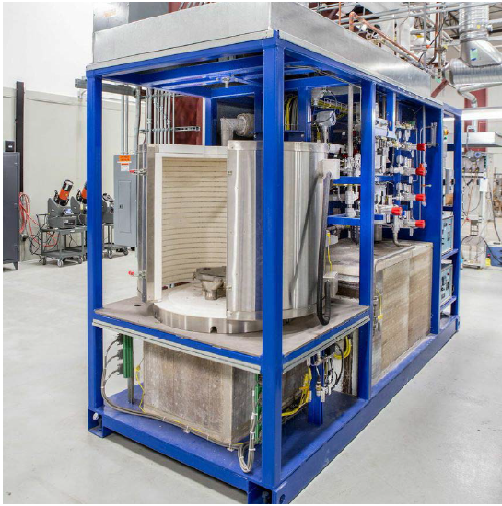
GE Fuel cell

Slide 30
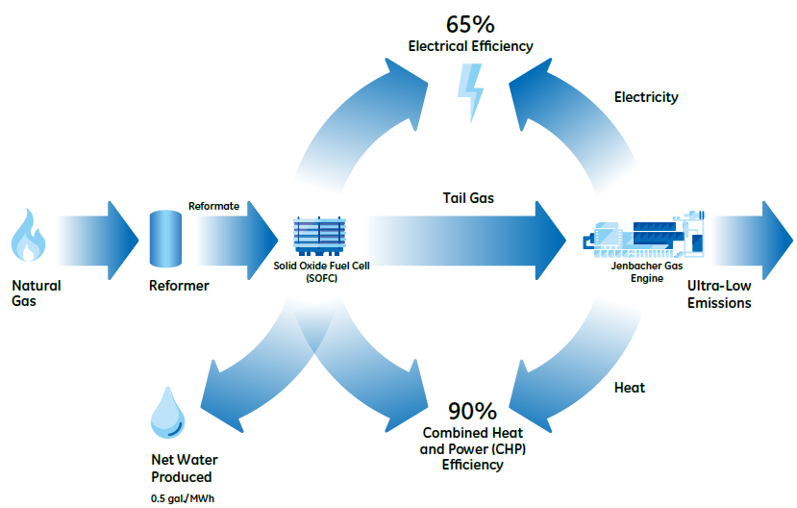
GE’s Fuel Cell-Combined Cycle (FC-CC) is a unique combination of a solid oxide fuel cell (SOFC) and a Jenbacher gas-fueled reciprocating engine. In this configuration, natural gas is reformed to produce hydrogen. The resultant reformate, along with oxygen, is used to produce electricity and water through an electrochemical reaction within the SOFC. The fuel output or tail gas is then fed to a Jenbacher gas engine in order to create more electricity and heat. The resultant electrical efficiency of the combined process is projected to be 60 to 65 percent. The combined heat and power (CHP) efficiency is expected to be as high as 90 percent.

Slide 31
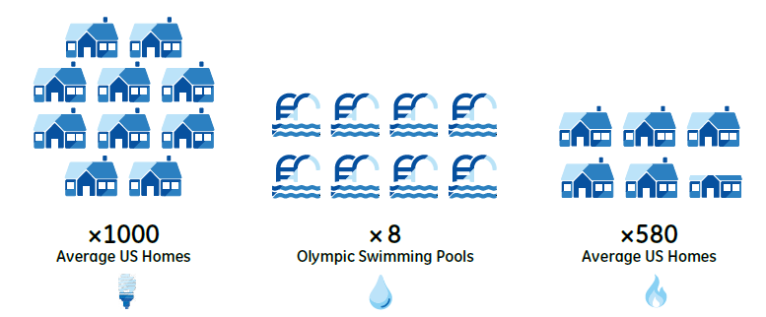
GE is in the process of developing a 1.3 megawatt (MW) Fuel Cell-Combined Cycle (FC-CC) system en route to the eventual development of a 10 MW system. The 1.3 MW system will produce enough electricity for 1,000 homes. Compared to the US power plant average water consumption rate, it will save enough water to fill eight Olympic swimming pools every year. Further, when compared to the US average natural gas-fired power plant,
the fuel savings due to the projected high efficiency of the FC-CC will be enough to meet the space heating, water heating, and cooking needs of 580 US homes every year.

Slide 32
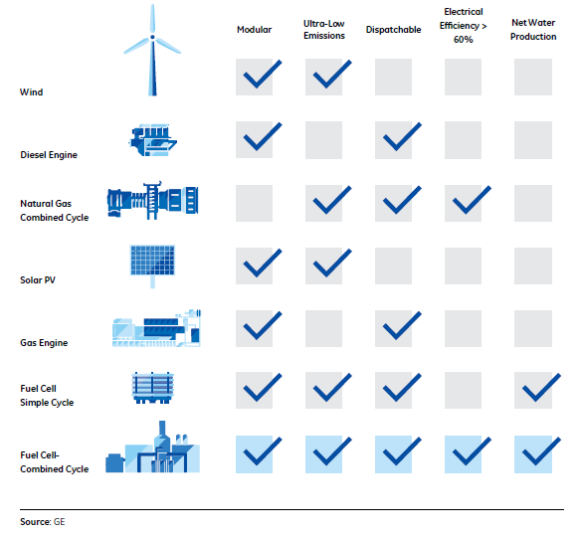

Slide 33
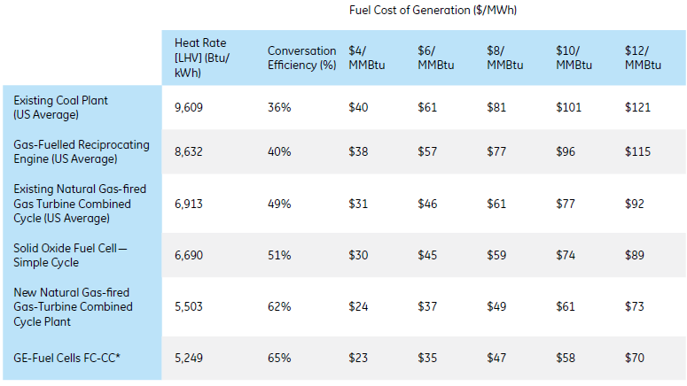

Slide 34
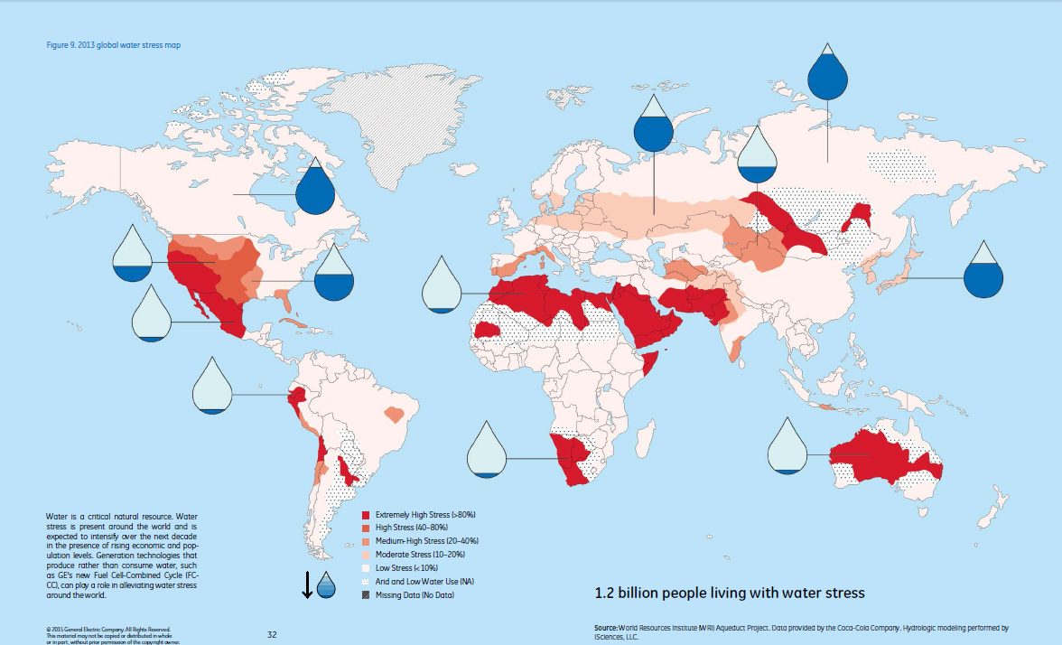

Slide 35
